Slide 1
Market Drayton Town Centre Strategy & Action Plan
Draft Report - May 2024

Slide 2
Market Drayton Town Centre - Strategy & Action Plan
1.0 Introduction to The Retail Group 2
2.0 Project Overview 3
3.0 Place Review 5
4.0 Survey of Businesses 14
5.0 Stakeholder Engagement 35
6.0 Resident Information & Wider Context 42
7.0 Trends & Benchmark Centres Review 49
8.0 Study Conclusions 55
9.0 Recommended Future Strategy & Action Plan 59
Appendices
I Business Survey Questionnaire
II Stakeholder Survey Questionnaire

Slide 3
Market Drayton Town Centre - Strategy & Action Plan
1.0 Introduction to The Retail Group
1.1 Company Background & Credentials
The Retail Group has been developing growth strategies and economic action plans for ‘places’ (cities, towns, local centres, market towns, historic towns, and streets) for almost 30 years and is at the forefront of helping places to become ‘multi-purpose’ in offer and use. This includes expansion of the offers and experiences in towns as well as improving use and integration of existing assets. Giving consumers more reasons for being in and visiting a centre, creating stronger ‘places’ to shop, enjoy, use, live, work and visit.
Over the last two years The Retail Group has developed comprehensive and coherent action plans to improve the performance, economy and prosperity of over 50 towns, locations and places. This period includes both pre, during and importantly post the Covid impacted and current economic pressured trading environment. It also includes detailed and multi workstream research studies that have identified the challenges, baseline performance, health checks and evidence base to direct individual town / location growth action plans.
The research processes utilised enables the team to get under the skin of each location quickly and effectively, successfully engage with local businesses and stakeholders, understanding its individual future needs and developing bespoke visions, strategies and practical action plans for the short, mid and longer term.
In almost 30 years of providing support to the wider retail, city / town centre and ‘place’ sectors, the prosperity and sustainability of over 350 diverse locations across the UK has been improved. The team has an unrivalled experience in developing, delivering and supporting the implementation of successful action plans and growth strategies. Included within the project team skill set is the awareness of the trends affecting how consumers choose to use town centres, and how places are evolving to meet the needs of consumers, businesses and demographic trends.
The Retail Group project team is at the forefront of helping places to become ‘multi-purpose’ in offer and use. This includes expansion of the offers, attracting additional elements, filing gaps, repurposing assets and providing the marketing and promotional content / direction to achieve the growth. Indeed, one of the current core aims for many places and the stated UKSPF objectives, to create and restore local pride and a sense of community in places has been a cornerstone of our work for almost three decades.

Slide 4
Market Drayton Town Centre - Strategy & Action Plan
2.0 Project Overview
2.1 Project Background and Brief
The Retail Group were initially appointed in late 2023 to develop an action plan to improve the performance of the regular weekly market offer in Market Drayton. At the time, the market was being operated by the specialist market operator LSD Promotions on behalf of Shropshire Council.
The market is considered to be an important part of the town centre’s offer, and a key anchor for the town. As such the Town Council decided that it should invest in preparing a plan to improve the market, so that it would help to improve the appeal and performance of the town centre.
In early 2024. Shropshire Council decided that it would not renew the license to operate the market with LSD Promotions, and going forward the market would be operated and managed internally by officers within the Council.
The Market Drayton Town Council working group had already expressed the desire to include the need to improve the wider town centre offer, appeal and experience, as part of the initial immersion and briefing discussions with The Retail Group project team. Given the decision of the County Council to bring the market management in house, the Town Council working group confirmed the wider objectives as including:
How to make the town more attractive?
How to attract large stores to the three large empty retail units in the town or how they could be repurposed (B&M Store / Wilko / Argos)?
How to encourage shoppers / visitors / tourists to the town?
The broad scope and approach of the study has remained the same and is set out overleaf. The key differences being in the business and stakeholder engagement, which now include a wider scope of engagement. Furthermore, the place reviews have considered the wider town offer, including the market, and the background information review, benchmark and trends analysis looks at activity in market towns as well as markets.
The purpose of this study is to identify the range of actions to be completed, in order to improve the performance of the town and the market, for the benefit of local residents, shoppers, visitors, traders and adjacent retailers. The aim is to provide detailed advice to the town council, identifying actions and initiatives to improve the town appeal and performance, with a clear indication of who should be included in the delivery and implementation of the identified actions.

Slide 5
Market Drayton Town Centre - Strategy & Action Plan
2.0 Project Overview
2.2 Project Methodology and Outputs
The core workstreams of the study are mapped out below:
Immersion - Included information collation, stakeholder contacts and contact protocols, stakeholder survey and business survey methodologies, timetable and sequence.
Information and Policy Review - Desk based review of current Council policies and development / regeneration plans for the town.
Town Centre Business Survey - All customer facing businesses, independent, confidential, high response rate, essential performance KPI’s and baseline information.
Place and Retail Review - Objective review, looking at offer, mix, attractors, retail and non-retail, environment, customer experience, facilities, access, transport, workplace, employment, community facilities and integration to community, to provide baseline information.
Stakeholder Engagement - Individual contact via personal email and online, targeting stakeholders as supplied by client project team.
Customer and Resident Needs Assessment - Review of available customer profile and lifestyle information, including growth in customer numbers
Town Centre Trends and Benchmark Locations Reviews - Review of emerging trends affecting how consumers shop at and use centres, as well as review of identified benchmark / exemplar places elsewhere in the UK.
Analysis and Conclusions - Analysis of individual research area findings and collective analysis.
Detailed analysis and interpretation of the findings of all workstreams to provide the following core outputs (as detailed in the briefing discussions, proposal documentation and subsequent email confirmation):
Market Drayton Town Centre Vision and Strategy
Market Drayton Town Centre Action Plan

Slide 6
Place Review

Slide 7
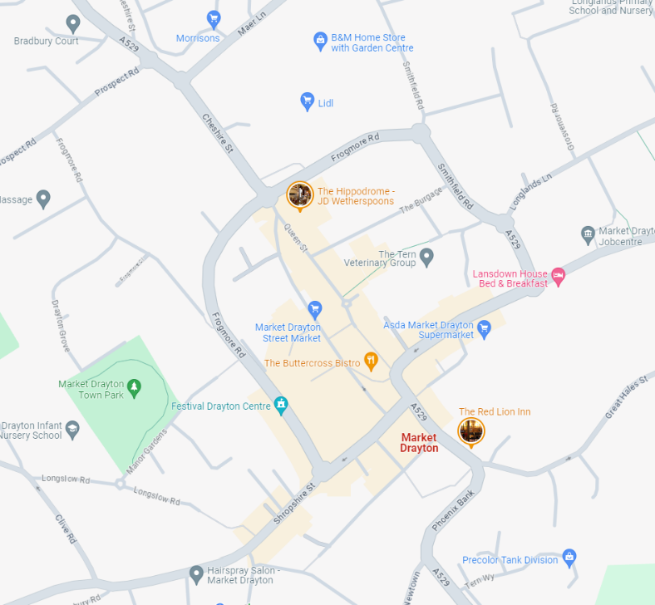
Market Drayton Town Centre - Strategy & Action Plan
3.0 Place and Centre Review
3.1 Introduction
Market Drayton is an historic and friendly market town in the middle of Shropshire’s dairy country. The streets of Market Drayton have much historic character with many half-timbered Georgian and Victorian buildings.
The town is in the middle of a large rural area, with larger centres some 30-40 minutes drive away, including Shrewsbury and Telford to the south, Crewe to the north, Wrexham to the west and Stafford / Stoke to the east. The local competing centres of Whitchurch and Newport are circa 20 minutes away by car.
The town and the town centre have much to offer, including, leisure venues for active sport and culture such as Festival Market Drayton. The natural environment assets are clear to see, although the Canal and its popular locks are not referenced in the town centre.
The town’s purpose-built brewery is in the town, visible on the plan, as Red Lion Inn, the livestock market remains a popular destination for its regular markets.
There are a number of supermarkets, many medium sized, such as Aldi (just off the top of the plan, Lidl and Asda (highlighted) and the largest supermarket Morrisons. All are close and visible to the town centre.
The main shopping area, shown as the buff-coloured area on the plan, includes four main streets. These have been reviewed in detail, as has the town’s weekly market.
The aim of the review is to look at what the town’s offer consists of, what the strengths of the offer are, the issues and the opportunities to improve the offer and overall experience of visiting and using Market Drayton Town Centre, to identify the gaps and who the right businesses are for those gaps.

Slide 8
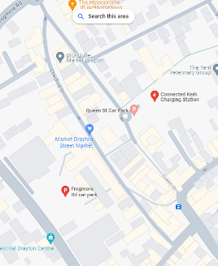
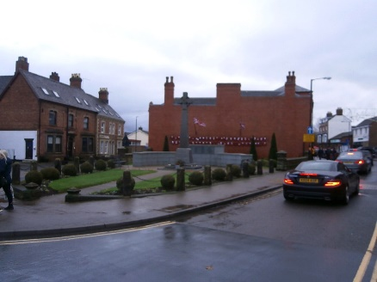
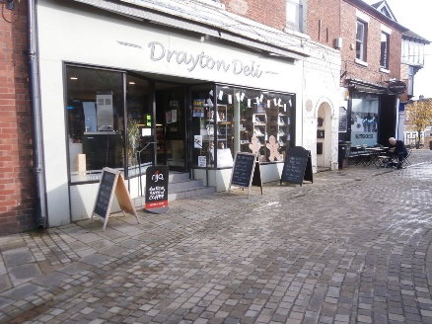
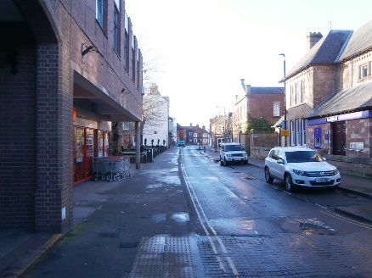
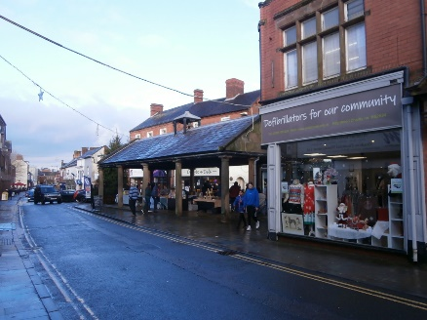
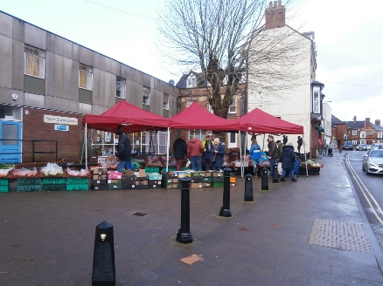
Market Drayton Town Centre - Strategy & Action Plan
3.0 Place and Centre Review
3.2 Cheshire Street
Cheshire Street is the main shopping street. It is also the home of the Wednesday Street Market, when the street is closed to traffic. During the rest of the week, it is a one-way street with popular and busy on street parking.
To the north is the town’s main ring road Frogmore Street, including Lidl, the relocated / expanded B&M stores, and Morrisons.
The offer is quite diverse, the review noted circa 55 businesses, including national brand names such as Boots, WH Smith, Iceland, Greggs and Costa Coffee. The street is dominated by independent businesses. There are plenty of service and health and beauty businesses (16 in number). There are also 5 convenience businesses, circa 8 food businesses including coffee shops and a takeaway. There are also a number of office-based businesses, quite a few charity shops and the library. Plus lots of good quality independent specialists, haberdashery, deli, café etc.
The environment is also quite mixed, with much of it not helping to increase the appeal of the street. The memorial garden at the north end is a positive. However much of the offer is hidden due to the sixties style overhang of much of the street. There are large areas of non active frontages. The narrow walkways and steady stream of vehicles also makes it feel unwelcoming. That said, the on-street parking is clearly popular and well used.
The better quality historic buildings, including the Buttermarket building, can be overshadowed by poor quality frontages and poor maintenance. Despite this, the street has few vacancies.

Slide 9
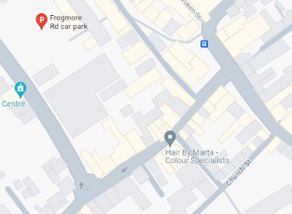
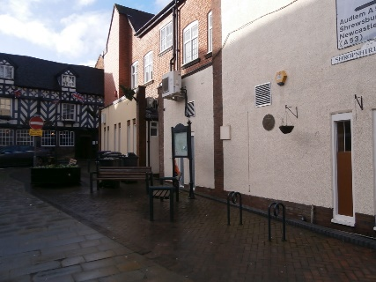
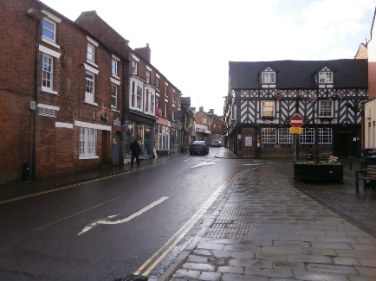
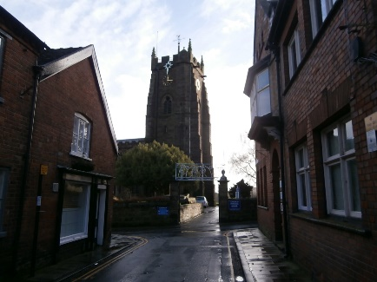
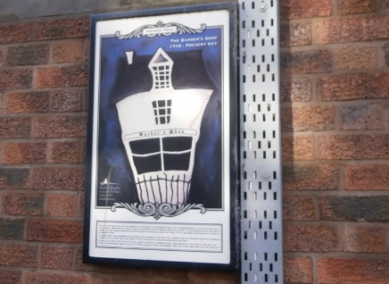
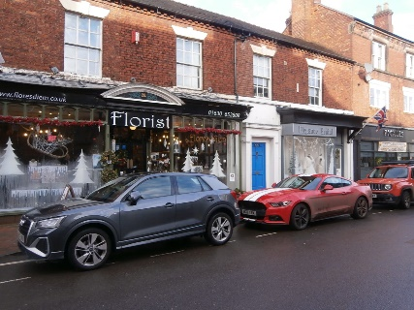
Market Drayton Town Centre - Strategy & Action Plan
3.0 Place and Centre Review
3.3 Shropshire Street.
Shropshire Street runs broadly in an east west direction and links the three other main retail streets, High Street, Stafford Street and Cheshire Street.
The offer consists of independent businesses, mainly smaller shop fronts, and includes a variety of different offers / categories.
The offer includes a much smaller cluster of businesses, circa 25, including hair and beauty, the biggest category, along with pubs, take-aways, service providers, specialist bridal, home and a couple of coffee shops.
The main business being the Tudor House Hotel, on the corner of Cheshire and Shropshire Streets, with its classic Tudor frontage, the building looks authentic, old, good quality and established, it does have a super presence.
At the High Street end, the environment is trying to be lifted by the public realm, seating and space, however the quality of the seating and the blank rear walls of shop units do not match that of the Tudor House Hotel.
The rest of the street does have a pleasant aspect, albeit with narrow footpaths. The Museum, St Mary’s Street (leading to the church) are not featured or used to help lift the appeal of the street. Again, the number of vacancies in this area are quite low, and the units are small.

Slide 10
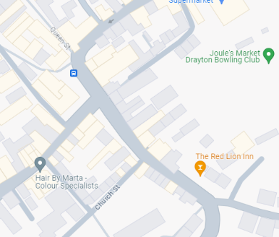
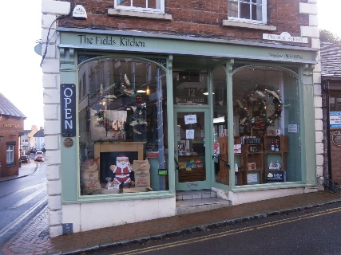
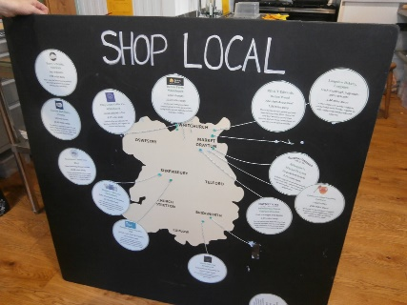
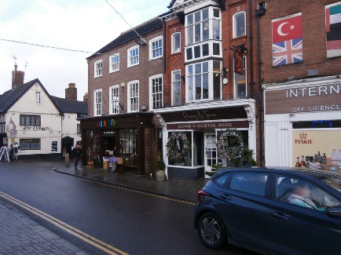
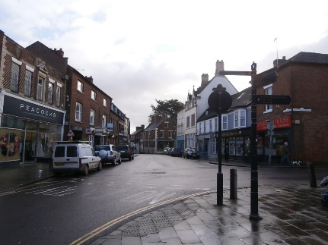
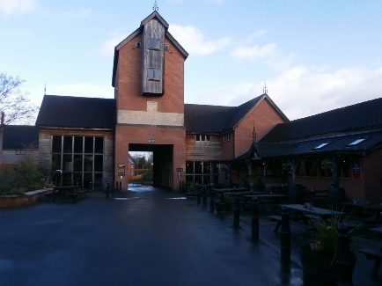
Market Drayton Town Centre - Strategy & Action Plan
3.0 Place and Centre Review
3.4 High Street
High Street begins with a small square offering a group of businesses set back from the road, at the northern end, where it connects to Stafford Street and the pedestrianised Queen Street.
It appears to be short street with all of its offer clearly visible, however it does extend around the corner and on to the Red Lion pub which is part of the Joules Brewery site and offer.
Like many of the town's streets, it has a broad mix of categories. The review listed 20 categories and circa 40 businesses, including a couple of national brand names, Peacocks and Post Office, plus banks. The bulk of the offer includes hair and beauty (10) and service providers (7). Beyond this there is a broad spread, including specialists such as home and bathroom, farm shops, florists, wedding, jewellery, charity and a number of catering businesses, day and takeaway.
There are a few more vacancies here, circa 6, although many of these are at far end from core area.
The benefit of High Street is that it feels open, easy to use, with pedestrian friendly spaces. Many of the units have larger shop fronts providing more impact and visibility than for those along Cheshire and Shropshire Streets.
It connects to the rear of the Buttermarket, via a pedestrian cut through.
The environment of this small, but central pedestrian core of the town could be much better with more external trading and seating for the catering / hospitality businesses.

Slide 11
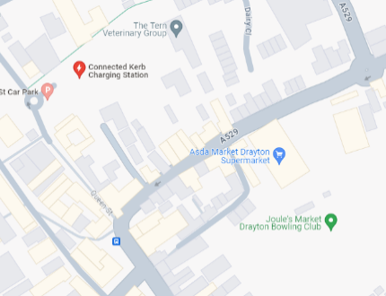
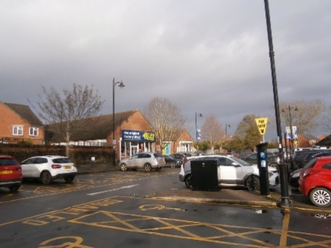
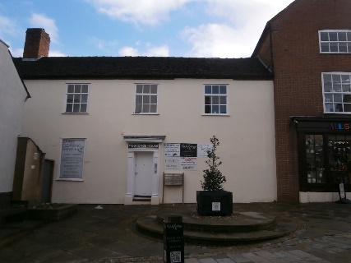
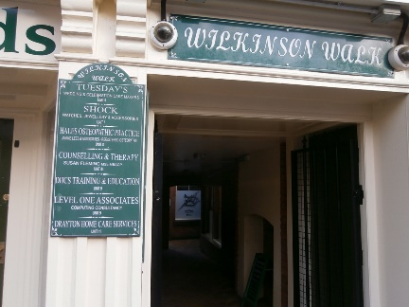
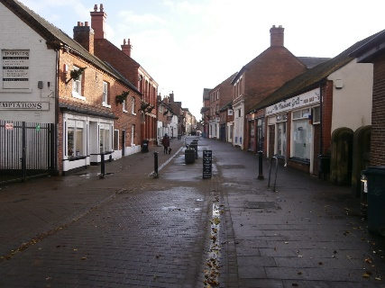
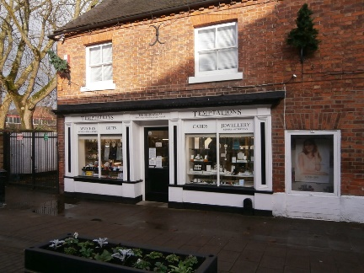
Market Drayton Town Centre - Strategy & Action Plan
3.0 Place and Centre Review
3.5 Stafford Street and Queen Street
From High Street or Queen Street it is easy to look down Stafford Street and assume that there is not much reason to go down it.
At the far end of the retail run is the smallish Asda foodstore.
The offer starts with a pub, one of many in the town centre, and on the other side of the road, a small set back area, with planter sponsored by the Town Council. The building adjacent appears to be non active, but is host to a group of service providers, house clearance to health and beauty.
The street has a pleasant historic charm with wood beam fronted buildings and a narrow streetscape.
Unfortunately, many of the buildings are in need of repair and maintenance.
The offer includes hair and beauty, services, residential, pub, clothing and gifts and a home business. Circa 20 businesses, including 2 vacant units, and a similar number of residential properties. A number of shops were also closed on the review visits.
Queen Street, the main reason for using Queen Street is to either use its car park, or to go to Original Factory Shop, which fronts onto the car park. Queen Street offers a number of cut throughs to Cheshire Street including Wilkinson Walk, a small arcade of very small shops that also fronts onto Cheshire Street.
There is a small pedestrianised part of Queen Street that links to High Street, it has a few trading premises, pizza, coffee, jewellers and a few vacant units. The street lacks the appeal of other places, it feels like the back of many buildings.

Slide 12
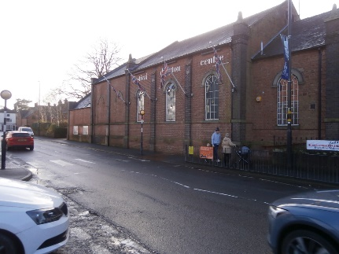
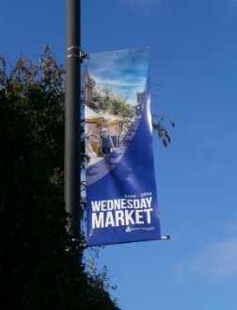
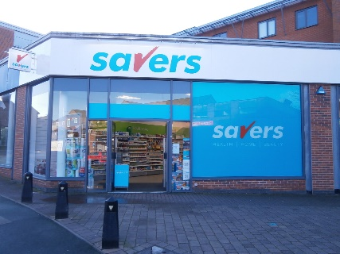
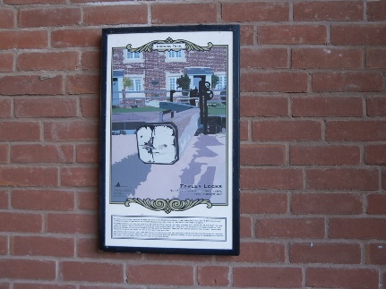
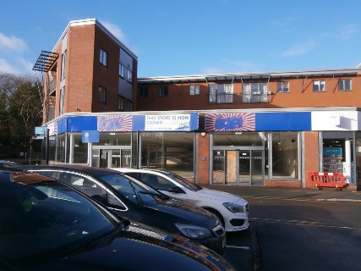
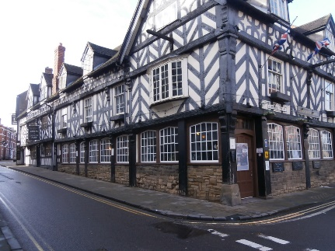
Market Drayton Town Centre - Strategy & Action Plan
3.0 Place and Centre Review
3.6 Other Areas of Town Centre
Frogmore Road and Frogmore Road Car Park
Frogmore Road is part of the main traffic route through and around the town centre. It does take visitors, users and residents to and past some of the major components of the town, including Festival Drayton Centre, Morrisons, Lidl, B&M Stores (new location).
It also passes close to several of the large empty units in the town centre, the former Wilko's unit, the former Argos unit and the former B&M stores unit. All of which are visible from the road and the car park off it.
The area around the Frogmore Road Car Park includes the Town Council office and visitor centre, the indoor market hall (very small and open only on select days), a Savers store and the closed Wilko. Argos and B&M stores.
Unfortunately, at the time of the review visits pre and post Christmas 2023 and into spring 2024 these stores are all adorned with large scale ‘THIS STORE IS CLOSED’ messages. These need to be removed, replaced or at least covered up with more positive messaging about the hundreds of open businesses in the town centre.
Frogmore Road Car Park is popular with shoppers, often having people waiting for spaces to become vacant, other car parks are around the town centre, plus there is on street parking on many streets.

Slide 13
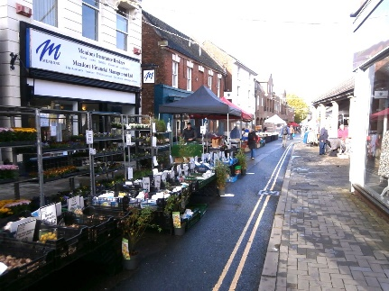
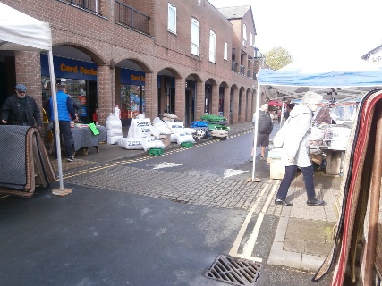
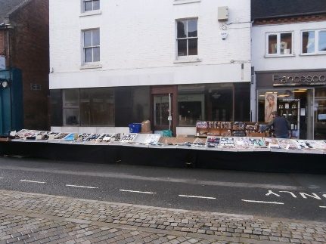
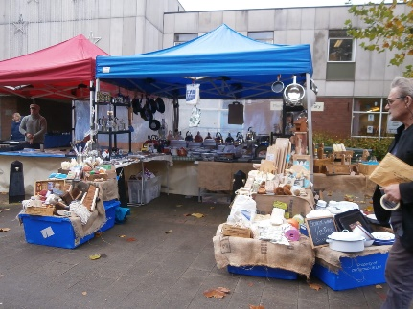
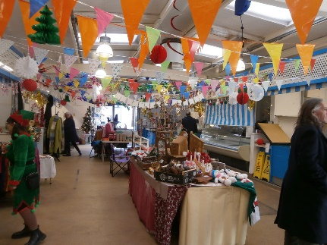
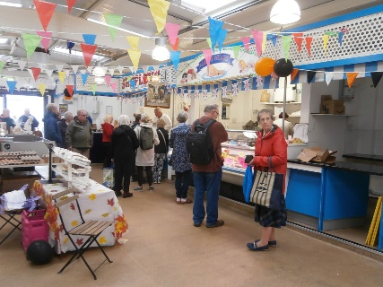
Market Drayton Town Centre - Strategy & Action Plan
3.0 Place and Centre Review
3.7 Town Market
The market trades on two days of the week, with the main day being Wednesday. Saturday is more of a supporting day. There is both a small indoor Market Hall, and an outdoor street market. The street market trades along Cheshire Street, with the road closed to traffic on a Wednesday. The Market Hall fronts onto Frogmore Road Car Park, although it is easily missed.
The outdoor street market benefits from being long established and in the same place. During the review there were a good mix of goods on sale (over 20 different categories) including fruit and veg, plants, socks, bedding, scarves, wool knitting, household, sweets, china / mugs, kitchenware, pre-owned, ladieswear and rugs.
The indoor market hall is very small, possibly the title is over selling the offer. It includes butcher, deli, eggs, gifts, chocolates, clothing. The butcher and deli businesses are clearly popular.
There is also a small artisan market under the Buttermarket, offering gifts, stained glass, sweets, cakes, baked goods, savoury and sweet, beers and frequently more categories.
Despite a broad selection of categories on the three markets, there are many aspects to improve for the markets, including signage and information, stall quality and fixtures, layout and space allocation, integration to each other and to shops and non active frontages, number of stalls / variety, promotion, availability of local produce to mention a few.

Slide 14
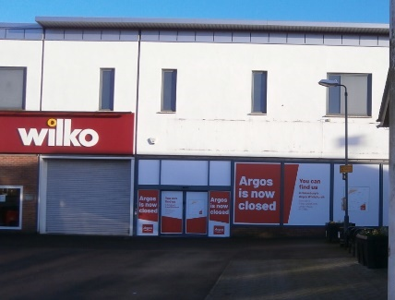
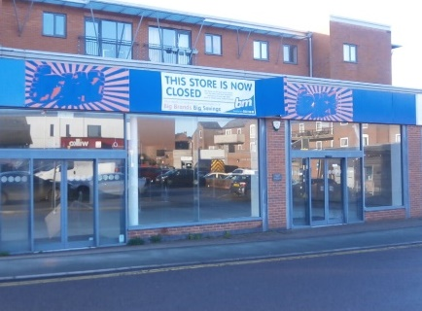
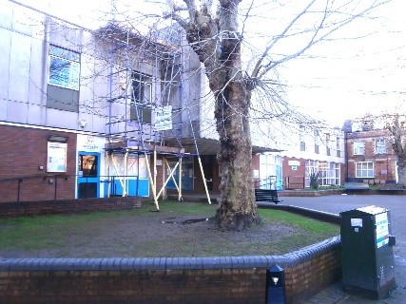
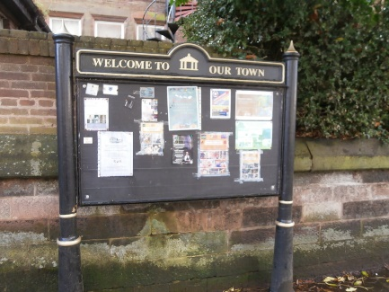
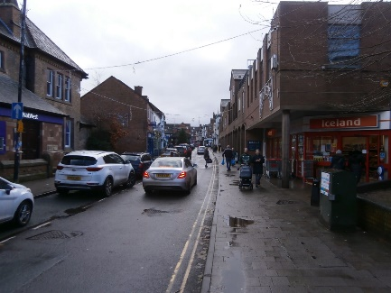
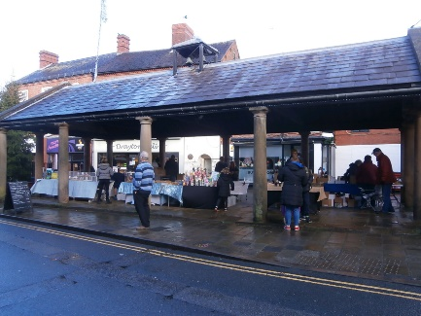
Market Drayton Town Centre - Strategy & Action Plan
3.0 Place and Centre Review cont’d.
3.8 Place Review Summary
Market Drayton Town Centre has much to offer the resident, regular customer and other visitors.
Strengths - lots of businesses active in the town centre, wide variety of uses, many good quality independents and specialists. Good occupancy levels in many parts of the town centre. Strong retail and non-retail anchors close to the centre. Active and social leisure activities close to the town centre. Strong convenience (food) service, personal care offers. Good base of catering and hospitality offers. A compact town centre. A reasonably strong market offer.
Weaknesses / issues - high profile vacancies, poor messaging to customers, poor integration / awareness of many local assets. Public realm in many visible parts of the town is poor, facilities don’t match quality of buildings. Retail offer is often hidden, lacking impact and visibility, Cheshire Street is particularly poor. The comparison goods offer is limited. The specialist goods offer can be easily missed. Connectivity of key components is confusing, and for a compact centre there is no clear route around it all. Finally, poor delivery of market along with limited choices.
Opportunities - increase the visibility of the existing offer, explore opportunities to share and distribute customers and visitors between attractions and components of the town centre. Make much more noise about what is in the town. Then attract more relevant and suitable businesses, there are plenty. Improve the market.
Threats - lack of funding, poor interest from property owners, who have bigger problems elsewhere. Increased appeal of other local and regional centres. Need to address physical issues to attract more businesses and customers.

Slide 15
Survey of Businesses

Slide 16
Market Drayton Town Centre - Strategy & Action Plan
4.0 Survey of Businesses
4.1 Introduction and Survey Distribution Area
The businesses trading in the town centre were contacted and surveyed for their views and aspirations for the town centre.
Questions in the survey were designed to capture information about the customer base, reasons for using the town centre, current and historic performance and views and opinions of the current offer and how the offer might be improved. Many of the individual questions and the survey format follows previous tried and tested questions, used successfully on many towns across the country.
A bespoke questionnaire was developed for the project, based on a combination of previous town centre business engagement surveys, market growth surveys and other surveys used in the development of successful town and place action plans.
The survey was distributed in person to businesses trading in Market Drayton on Wednesday 21 February (a market day) and Thursday 22 February. Completed surveys were collected later on the same day.
The questionnaire is attached as Appendix I. Given the excellent response and participation rate achieved, we recommend that it is used on an annual or biannual cycle as the basis for ongoing monitoring of performance and improvement initiatives.
87 completed surveys have been collected in total, out of circa 128 distributed, which equates to a 68% response rate. The level of participation would indicate that businesses are interested in the future of the town centre.
The results of the business survey are reported over the following section. The area covered in the survey is shown on the plan overleaf.
Note due to multiple responses allowed, not all graphs in the following section total 100%.

Slide 17
Market Drayton Town Centre - Strategy & Action Plan
4.0 Survey of Businesses
4.1 Introduction and Survey Distribution Area cont’d.

Slide 18
Market Drayton Town Centre - Strategy & Action Plan
4.0 Survey of Businesses
4.2 What type of business do you operate?
The survey achieved a good spread of key retail categories, including 18 responses from market traders.
The response mix, reflects the broad mix of the town centre, and provides a good base for analysis.

Slide 19
Market Drayton Town Centre - Strategy & Action Plan
4.0 Survey of Businesses
4.3 In your opinion, what are the main reasons for customers to be in Market Drayton these days?
In regards key reasons for customers to visit the town centre, there are multiple reasons for visiting, with living nearby dominating the list.
Working nearby and shopping generally, using health and beauty services, and eating / drinking are the main secondary reasons.
Market specific shoppers also feature strongly given the market being mainly on Wednesdays. Tourist and leisure users are less of a noticeable visit driver.

Slide 20
Market Drayton Town Centre - Strategy & Action Plan
4.0 Survey of Businesses
4.4 Which of the following best describe your customers?
In terms of customer profile, two descriptions dominate, regulars and elderly. Beyond this, a third of businesses have browsers.
That said, a third of businesses also report family groups and young customers.
Customers are also value and quality seekers. Time pressed and an interest in fashion are not words used to describe existing customers.

Slide 21
Market Drayton Town Centre - Strategy & Action Plan
4.0 Survey of Businesses
4.5 How often do your regular customers typically visit you? What is the trend to last year?
The town centre attracts a high customer visit frequency pattern, with most businesses telling us their customers visit either daily or multiple times a week.
72% of businesses achieving at least weekly visits, 43% achieving multiple times a week, which indicates a local and loyal customer base.
Businesses were also asked about trends in visit frequency to last year; 46% reported lower visits, 33% about the same level and only 9% increased visits, compared to last year. The reported national picture for footfall is mixed, with some towns now stabilised, the information for Market Drayton does seem to be worse than national information.

Slide 22
Market Drayton Town Centre - Strategy & Action Plan
4.0 Survey of Businesses
4.6 How long have you traded in Market Drayton?
4.7 Approx. what percentage of your sales come from local workers?
Half of Market Drayton businesses have been in the town for over 10 years. A good established base, indicating long term reliability of trade.
A number of new businesses have opened, and a quarter have been open for between 1 and 5 years.
Businesses are choosing to come to Market Drayton.
A quarter of businesses are very reliant on local workers. A further quarter are less reliant and circa half are not appealing to local workers, or don’t know.

Slide 23
Market Drayton Town Centre - Strategy & Action Plan
4.0 Survey of Businesses
4.8 Sales levels; are they up, down or level with previous years? 4.9 What are your busiest trading days?
Circa half of businesses report that they are level or up compared to last year, whilst just over a third say they are down.
A more positive finding than the footfall trend. Fewer customer visits but for some spend is increasing.
Clearly market day and the market has a clear impact on trading day performance.
Saturday remains the dominant day, but not as dominant as it might be
Friday and Wednesday are close second in terms of peak trading days.

Slide 24
Market Drayton Town Centre - Strategy & Action Plan
4.0 Survey of Businesses
4.10 Satisfaction with performance of your business? 4.11 Satisfaction with performance of Market Drayton as place to trade?
Despite falling footfall and tough trading for many businesses, almost 60% are ‘satisfied’ with their performance. Only 20% dissatisfied.
A 3:1 positive ratio.
A more positive finding than the footfall trend. Fewer customer visits but for some spend is increasing
Clearly businesses are less satisfied with Market Drayton as a place to trade. 60% are ‘dissatisfied’ only 18% satisfied, a 3:1 negative perception.
The reverse perception to that of their own business.

Slide 25
Market Drayton Town Centre - Strategy & Action Plan
4.0 Survey of Businesses
4.12 Over the next two years do you think business performance in Market Drayton will?
Close to two thirds of businesses expect further decline in business performance over the next two years.
A clear reflection on current performance and the lack of any positive indicators for change.
Only a third of businesses think the outlook will stay as it is now or improve slightly.

Slide 26
Market Drayton Town Centre - Strategy & Action Plan
4.0 Survey of Businesses
4.13 What are your business’s plans for ongoing trading in Market Drayton?
Most businesses are planning to remain in their current premises. Many are planning to positively adapt, add ranges, add services or expand.
Only 8% expect to close, whereas 7% expect to expand, 5% expect to relocate within Market Drayton.
A strong / positive finding given the challenging trading for many.

Slide 27
Market Drayton Town Centre - Strategy & Action Plan
4.0 Survey of Businesses
4.14 In your opinion, how much of a draw / benefit is the market to your business in regards generating footfall?
The market is considered to be a draw / generator of footfall by most businesses, although a third don’t recognise it as generating footfall for their business.
The market is clearly an asset that could be stronger and provide more benefit than it already does.

Slide 28
Market Drayton Town Centre - Strategy & Action Plan
4.0 Survey of Businesses
4.15 How would you like the market in Market Drayton to be improved?
The key improvements to the market offer include make it bigger with more stalls, add more quality stalls and add more hot food.
Beyond that, four aspects all feature at similar levels, better quality product, more stalls closer together, longer trading day for the market.
Business were given the option to reduce the size of the market and the hot food offer, this was not selected by any business.
A larger, stronger, better-quality market is required by the businesses in the town centre.

Slide 29
Market Drayton Town Centre - Strategy & Action Plan
4.0 Survey of Businesses
4.16 Which specific operators, categories or brands do you feel would benefit Market Drayton and its customers if they traded here?
Clothes shops | 29
Home shops | 18
Shoes | 17
Independents | 16
More multiple branded shops | 15
Food | 7
Café / restaurant | 6
Leisure / entertainment | 6
Fewer charity | 3
Better parking / bus | 2
No more hair / barbers | 1
This question was open ended and unprompted. Circa 114 different suggestions were made, some businesses made multiple suggestions a few made no suggestions.
The response were sorted and grouped for ease of reporting. Businesses feel that greater choice in shops and types of retail businesses is most needed. Many identify certain names including Primark, TK Maxx, Sports Direct. However, many more focus on independents, specialists and home related categories.

Slide 30
Market Drayton Town Centre - Strategy & Action Plan
4.0 Survey of Businesses
4.17 How would you like the mix and offer of Market Drayton to be improved?
A very strong response to this question, with multiple options being selected by many businesses.
More independents, more shops, more / better markets all at 60% or more.
More events identified by almost half of businesses, more leisure facilities, more arts and cultural, and more hospitality outlets.
A clear demand for a stronger more diverse centre, appealing on many levels.

Slide 31
Market Drayton Town Centre - Strategy & Action Plan
4.0 Survey of Businesses
4.18 How would you like the environment of Market Drayton to be improved?
Lots of opportunities to improve the environment, not as strongly demanded as the offer.
Improved cleaning, lighting, sense of arrival, and make more of the heritage.
Improve the public realm and include more greening / green spaces.

Slide 32
Market Drayton Town Centre - Strategy & Action Plan
4.0 Survey of Businesses
4.19 How would you like overall experience of customers who visit Market Drayton to be improved?
A broad range of areas identified for improvement.
Improved customer facilities, better pavements, more customer toilets, improved safety and better ASB deterrents like CCTV.
Much more for customers, seating, information, signage and wayfinding.
Improved traffic management is also required.

Slide 33
Market Drayton Town Centre - Strategy & Action Plan
4.0 Survey of Businesses
4.20 Please rate how strongly you agree or disagree with the following statements?
Businesses are clear in their responses to the ‘agree / disagree’ statements.
They view tourists and visitors as important; the town needs more promotion of its offer and greater awareness.
They are concerned about the future trading prospects.
They also agree but less strongly that the town needs to be more family friendly, and they would recommend it as a place to trade.
The market is not viewed as the biggest attraction.

Slide 34
Market Drayton Town Centre - Strategy & Action Plan
4.0 Survey of Businesses
4.21 And finally, is there anything else you wish to add about Market Drayton and / or its market, especially in regards your future improvement aspirations?
Improve the market | 20
Action, refurbishment | 16
Parking, free on Wednesdays, more | 11
Cheaper rents | 10
More promotion / advertising | 8
Better bus / travel / access | 7
Better leisure | 7
More variety / diversity | 6
Business were asked for any further unprompted comments.
We received 87 comments, although not at a rate of 1 per respondent, many businesses gave no comment, those that did are listed in the table, in summarised format.
The responses mirror much of what has already been reported, improve the market, improve the town centre condition, more promotion, more variety.
The parking comments, about free on Wednesdays, more parking and improved bus access and traffic management are provided multiple times.

Slide 35
Market Drayton Town Centre - Strategy & Action Plan
4.0 Survey of Businesses
4.22 Key Point Summary
Survey of businesses has achieved a very good response from businesses in Market Drayton, with 87 completed surveys.
Businesses tell us that customers live and work locally, and come into town for shopping, personal care / beauty services, and socialising / meeting friends.
Customers are typically described as elderly and regulars, a third of businesses also see family groups and young customers.
Visit frequency is high, with half of businesses receiving multiple visits a week. The year-on-year visit trend is down.
There is a strong established business base, and a few newer arrivals, businesses are choosing to locate in Market Drayton.
Local workers are very important for a quarter of businesses and play a part for all businesses.
Year on year trading experience is positive in the round, half are level or up, and a third are down.
Saturday is the peak trading day, just. Wednesday (market day) and Friday are fairly close to it.
Businesses are satisfied with their performance but dissatisfied with Market Drayton.
Businesses are negative about future trading prospects, that said they intend to stay, adapt and evolve.
The market is viewed as a draw for the town and a benefit for most businesses. It needs to improve, be bigger, better quality, have more food, trade longer.
The town needs to improve its offer, more clothing, home, footwear, leisure, arts / culture. Plus branded and independent shops.
The town also needs more markets, more events, more promotion, more activity.
The businesses identified lots of opportunities to improve the environment and experience, cleaner, more greening, better lighting, pavements, information, signage, wayfinding, arrival and a few more aspects.
Businesses agreed strongly that ‘tourists / visitors are important’, ‘the town needs more promotion’, ‘they are concerned about the future prospects’.
They agreed less strongly that ‘the market is not a strong attraction’, the town needs to be family friendly’.
A good mix of strong evidence and clear direction / input into the town strategy and actions.

Slide 36
Stakeholder Engagement

Slide 37
Market Drayton Town Centre - Strategy & Action Plan
5.0 Survey of Stakeholders
5.1 Introduction
A bespoke stakeholder questionnaire was developed for the project to survey stakeholders. The questionnaire is based on previous tried and tested questionnaires used in other similar projects. The questionnaire includes a selection of mostly open-ended questions for stakeholders to provide views, opinions and aspirations. It also includes a number of prompted answer questions, whereby the views of facets about the town are explored. A copy of the stakeholder questionnaire is attached as Appendix II.
A list of potential stakeholder contacts to survey / engage was provided by the Town Council project team. In some instances, such as local parish councils, the clerk was contacted.
The target list of stakeholders included, town councilors, local parish councils, county council officers, local business owners, local growers and producers, leisure, arts and culture operators, the market operator, local police and several operators of local events. In total 18 stakeholders were contacted, over a four-week period. Each stakeholder is contacted up to three times. 12 stakeholders returned surveys, providing a useful foundation of internal and external views and opinions about the town, market and improvement needs.
Given the number of responses and the mix of open ended and prompted questions the results are reported in either table and / or written summary comments. We are very grateful for the time and input from the stakeholders, which included the following:
Parish Council
Festival Drayton Centre
Fordhall Farm Ltd.
Local councillor
Local residents
LSD Promotions
Shropshire County Council Markets Team
Visitors to the town
West Mercia Police

Slide 38
Market Drayton Town Centre - Strategy & Action Plan
5.0 Survey of Stakeholders
5.2 Strengths & Weaknesses
The following table summarises the responses received for Market Drayton Town Centre. The tables include those aspects mentioned by more than one stakeholder. In some instances, responses have been grouped together in similar topics / themes. The number of mentions are also listed.
Strengths |  | Weaknesses
Easy parking | 6 | Limited variety | 10
Historic assets, canal, location / monument | 6 | Condition of town centre / pavements | 5
Cultural centre / Festival Drayton / events | 5 | Poor weekly market | 4
Growing population | 3 | Parking | 4
Independents | 2 | Empty shops | 4
Connectivity | 2 | Lack of promotion | 3
Indoor market | 2 | Lack of accommodation | 3
Library | 2 | Poor connectivity / bus | 2
Charter market | 2 | Opening times | 1
Compact town centre | 2 | Apathy | 1
Supermarkets | 2 | Few events | 1
Range of services | 2 | Anti social behaviour | 1
Charity shops | 1
The strengths identified by stakeholders are focussed on the existing assets; canal, heritage, monuments, historic buildings and parts of the environment. However,the ease of parking is viewed as a key strength. Aspects of the offer are viewed as minor strengths.
Weaknesses are dominated by limitations of the offer, condition of parts of the town and the environment, poor weekly market, empty shops, lack of promotion and accommodation.

Slide 39
Market Drayton Town Centre - Strategy & Action Plan
5.0 Survey of Stakeholders
5.3 Missing Offers, Categories & Themes
Stakeholders were asked to name any specific offers, categories or operators they felt would benefit Market Drayton. The following table summarises the responses received for Market Drayton Town Centre. In some instances, responses have been grouped together in similar topics / themes.
Offers, Categories and Themes missing
More independents | 6
More choice / variety | 6
Food retailers | 5
More café culture | 4
Clothing | 4
Hardware | 3
Art supplies, leisure, soft play | 3
Primark, Dunelm, Superdrug | 3
Bus routes / parking | 2
Themed markets | 1
More events | 1
Needs stronger identity | 1
In terms of what is missing, the list is varied and extensive, this does provide lots of opportunities to add to the overall offer and appeal of the town centre.

Slide 40
Market Drayton Town Centre - Strategy & Action Plan
5.0 Survey of Stakeholders
5.4 Improvements to Mix and Offer
5.5 Improvements to Environment
Mix / Offer Improvements |  | Mix / Offer Improvements
More independent shops | 12 | Better evening economy offer | 7
More shops overall | 10 | More multiple operators (chains) | 5
More cafes and restaurants | 10 | More / better leisure facilities | 5
More / better markets | 10 | More residential units above shops | 4
More arts / cultural attractions | 8 | More pubs and bars | 1
More / better events | 8
Environment Improvements |  | Environment Improvements
More focus on heritage | 9 | Better lighting | 5
Better sense of arrival | 8 | Public realm improvements | 5
More public art | 6 | Cleaner / tidier | 4
More trees / green space | 6
5.6 Improvements to Experience
Experience Improvements |  | Experience Improvements
Less vacant premises | 12 | More customer toilets | 3
Improved facilities for cyclists | 6 | More customer seating | 3
Improved pavements | 5 | Better traffic management | 3
Improved signage | 4 | More / better CCTV | 3
More customer information | 4
Stakeholders are consistent in the improvements to offer and mix. More shops, cafes, restaurants, markets, events and cultural attractions lead the list. Indeed, simply providing more would be a clear ask.
Equally, there are many opportunities / requirements to improve the towns environment and customer experience. Focus on heritage, stronger arrival, more greening, improved public realm and customer facilities.

Slide 41
Market Drayton Town Centre - Strategy & Action Plan
5.0 Survey of Stakeholders
5.7 Future Trading Prospects
5.9 Benchmark Centres & Locations
In regards the prospects for Market Drayton, the response is quite mixed.
5 stakeholders were pessimistic, 2 were very optimistic, 2 optimistic and 3 undecided. There is clearly a requirement to improve the outlook..
The centres that were mentioned multiple times included:
Nantwich (7) - Due to the variety, independents, markets.
Whitchurch (7) - Attractive buildings, variety, independents, markets.
Newport (5) - Variety, independents.
Shrewsbury (3) - Environment, independents.
Eccleshall (2) - Place and offer.
Wellington and Ludlow had 1 mention each.
5.8 What Kind of Place should Market Drayton be?
Stakeholders were very clear in the core ambition for Market Drayton.
It should be ‘a thriving and vibrant town centre’ (9 responses).
Other responses included:
Provide more diversity in offer and appeal (4).
Provide amenities for all ages (3).
Offer more unique businesses (2).
Provide more events (2).
Give more entertainment (2).
Make use of canal, more culture, integrate surrounding assets and countryside, a place to visit and stay, more for families all secured 1 mention.
5.10 Agree / Disagree Statements
Stakeholders were presented with five statements and ask to indicate the extent to which they agreed with the statements.
Respondents either clearly agreed with:
Tourists and visitors are important to the centre.
Market Drayton needs more promotion.
Market Drayton needs to be more family friendly.
I am concerned about the prospects for Market Drayton.
They were ambivalent in regards being able to recommend Market Drayton.

Slide 42
Market Drayton Town Centre - Strategy & Action Plan
5.0 Survey of Stakeholders
5.11 And Finally … Anything Else to Add?
5.12 Summary
This open-ended question provided a wide variety of responses from many stakeholders. The listing below details the points with multiple mentions:
Focus on whole town (5).
Refresh town centre (4).
Use canal (4).
Free parking on market day (3).
Improve transport links (3).
Include key stakeholders (2).
More accommodation for visitors (2).
Improve the market (2).
More civic pride, local support (3).
Make more of charity shops, its on trend (2).
More, free to use kids play & pre-school activities (2).
In addition, comments included, more pedestrian priority in town centre, more Gingerbread Festivals and more farm shops in town.
The stakeholder information can be summarised as a SWOT analysis:
Strengths / Positives - easy parking, historic assets, canal, surrounding countryside, cultural assets & attractions, events.
Weaknesses / Issues - lack of variety, limited offer, high profile empty shops, condition of parts of town centre, environment, lack of promotion, accommodation and some access issues.
Opportunities - more independents, shops, cafes, services, leisure, events, markets, improved market, and visit drivers. Improve built environment, facilities, pavements, toilets, information, signage. Make better use of existing assets, differentiators. Make town more welcoming, cleaner, greener, safer. More impact and memorable, stronger identity.
Threats - do nothing, continued decline of market and town centre, loss of customers to nearby centres, vacant properties dominate the town, lack of promotion to locals and visitors.
Conclusion - the overall offer and experience needs to be stronger and more varied. It needs a coordinated and collective approach.
However many of the building blocks are in place, they need nurturing, improving, highlighting and capitalising on. Customers, residents and visitors are available (present and nearby) to be captured and retained.

Slide 43
Resident Information and Wider Context

Slide 44
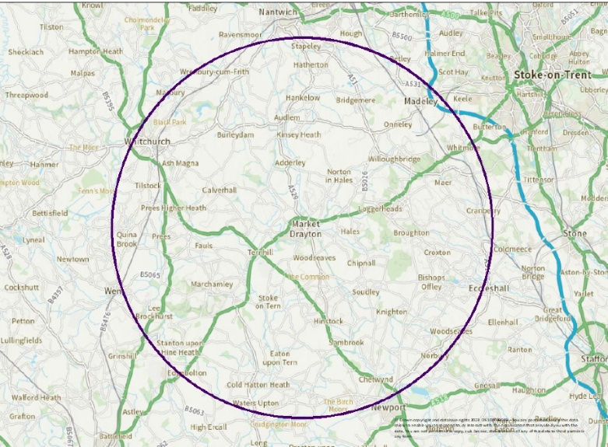
Market Drayton Town Centre - Strategy & Action Plan
6.0 Resident Information and Wider Context
6.1 Introduction
This section of the report provides two areas of input into the Market Drayton Town Centre Future Strategy & Action Plan.
The first aspect is to summarise the available information about the established Market Drayton residents. Much of this information is sourced from the reports provided by the Town Council and produced by Shropshire Council.
As can be seen from the adjacent map, which shows a ten-mile radius around Market Drayton, the town has a very rural hinterland, and is separated from the surrounding major centres. The population in this area is circa 71,300.
Market Drayton is recognised in the Shropshire Local Plan as being one of the five ‘principal centres’ in the county, at a level below Shrewsbury. The county is a rural county and has a low density of population per hectare, considerably below the Midlands and National averages. 35% of all the county residents live outside of the major centres.
Shropshire has an estimated population of 323,000 people living in circa 138,000 homes.
Market Drayton is well placed and accessible by road and the national canal network.
The second part of the section then provides more background and wider context information about Market Drayton as a principal centre and includes information from the current Shropshire Local Plan, recent town audits completed by the County Council and the current Town Profile Report, also compiled by the County Council. These reports provide good quality information about the resident base, workforce, and the wider aspirations and planning direction for the town.
Tamworth Borough Council
Local Plan 2006-2031
Adopted February 2016

Slide 45
Market Drayton Town Centre - Strategy & Action Plan
6.0 Resident Information and Wider Context
6.2 Resident Information
Resident Information
There are circa 12,300 residents in Market Drayton.
The total catchment area for Market Drayton includes 107,700 residents.
The town has a younger age profile than Shropshire but older than GB.
A broad spread of employment types
Director level, professional and associate professional categories are a little below England or Shropshire.
Skilled, semi-skilled, care sector, machine operators are above England and Shropshire averages.
Unsurprisingly average household income is lower than Shropshire average.
Household Information
Circa 5,200 households in Market Drayton.
During the Local Plan period, to 2038, Market Drayton is anticipated to provide around 1,200 new dwellings.
Current housing stock includes, 33% detached, 39% semi-detached, 16% terraced and 8% flats.
Two thirds of properties are owned outright or with a mortgage.
45.5% of working people who live in Market Drayton also work there.
Significant numbers commute into the town from Telford and Wrekin, Cheshire East, Stoke on Trent, Newcastle under Lyme and Stafford.
Employment
Market Drayton is an important employment hub, third largest in county.
Circa 5,500 jobs in town council area.
The four largest employment sectors in Market Drayton are manufacturing, wholesale, retail and transport & storage.
7,300 Market Drayton residents are of traditional working age (16-64).
437 businesses have registered offices in Market Drayton.
79.4% of residents were economically active.
8.6% of workforce are employed in tourism related jobs, below Shropshire average of 14.7%.

Slide 46
Market Drayton Town Centre - Strategy & Action Plan
6.0 Resident Information and Wider Context
6.3 Shropshire Local Plan 2016 to 2038
Shropshire Local Plan 2016 to 2038. A selection of relevant points extracted from the 360 page document | The role of the Shropshire Local Plan is to set out a meaningful and positive framework at the local level to inform decision making for the benefit of the County. This relates to both strategic issues, such as the amount of growth proposed and how it is distributed, and how the County moves towards a net zero carbon economy, through to more detailed issues, such as the design and layout of new development and how environmental assets are to be protected. The Shropshire Local Plan sets out broad planning policy and development guidelines / principles for the county. It also provides detailed direction for all the major settlements, including Market Drayton. Spacial Vision - “In 2038, communities will be safe and healthy as Shropshire moves positively towards a zero carbon economy; all residents will be able to access well-designed, decent and affordable homes in the right location; economic productivity will be maximised through greater investment; and the County’s historic and natural environmental assets will be protected and enhanced”. ‘The Shropshire Test’ - Development will contribute to meeting local needs and making its settlements more sustainable, providing the right mix of new housing, employment and other types of development which: Supports the health, well-being and safety of communities Supports cohesive communities Addresses the causes and mitigates the impacts of climate change Conserves and enhances the high-quality natural environment and provides opportunities for green and blue networks Raises design standards and enhances the area’s character and historic environment Makes efficient use of land Provides sufficient infrastructure, services, facilities, and where necessary provides opportunities for their enhancement.

Slide 47
Market Drayton Town Centre - Strategy & Action Plan
6.0 Resident Information and Wider Context
6.3 Shropshire Local Plan 2016 to 2038 cont’d.
Shropshire Local Plan 2016 to 2038. A selection of relevant points extracted from the 360 page document | Strategic Approach and Policy Extracts 4. Main town centre uses will be focused into the diverse network of town centres and recognisable high streets across Shropshire. It will complement their scale and character and support appropriate diversification. 5.b. Principal and key centres will accommodate significant well-designed new housing and employment development, supported by necessary infrastructure. Growth within these diverse settlements will maintain and enhance their roles, support key services and facilities and maximise their economic potential. SP5 Design - Development must maintain and enhance the character, appearance and historic interests of settlements, street scenes, groups of buildings, individual buildings and the landscape. DP9. Managing and Supporting Town Centres There is a presumption in favour of proposals for main town centre uses within defined town centres; Proposals for non-town centre uses within town centres, including residential, will be considered acceptable where they would support the vitality and viability of the town csentre DP10. Tourism, Culture and Leisure Supporting new and extended tourism development, and cultural and leisure facilities, that are appropriate to their location, and enhance and protect the existing offer within Shropshire Promoting connections between visitors and Shropshire’s natural, cultural and historic environment, including through active recreation, access to heritage trails and parkland, and an enhanced value of local food, drink and crafts Promoting and preserving the distinctive historic, heritage brand values of Shrewsbury, the Market Towns and rural areas
S11 Market Drayton Place Plan | New retail development will be directed towards the town centre and will need to contribute to the historic town character. There may be opportunities to deliver a marina and related uses on land at Victoria Farm. Market Drayton will fulfil its role as a principal centre, acting as a focus for strategic growth objectives in the north-east of the County.

Slide 48
Market Drayton Town Centre - Strategy & Action Plan
6.0 Resident Information and Wider Context
6.4 Market Drayton Town Centre Audit Analysis 2023
Market Drayton Town Centre Audit Analysis 2023 Completed by Shropshire Council | Key Findings – typically contrasted / compared to other Shropshire centres. 131 commercial units, occupying 16,800m2 gross floor space – consistent figure over 5 years. 5th largest centre in Shropshire behind Shrewsbury, Oswestry, Bridgnorth and Ludlow. Low number of stores per head of population at a rate of 11 units per 1,000 population (13 on average for Shropshire). Average store size 128m2 which is slightly smaller than the average across Shropshire (147m2). 135 residential premises in the main shopping area, giving a ratio of almost 1:1 commercial versus residential properties. 13% of all commercial premises were vacant in 2023, which is higher than the Shropshire average (11%), note only 7% of floorspace, indicator of small units being vacant (prior to Wilko and Argos). The town comprises predominantly independent retail, although the centre is large enough to have attracted several chains Town has small comparison, convenience, leisure, accommodation, tourism and F&B offers, and strong for all services 68% of visitors to the town come from 2 postal districts (TF9 and CW3). High visit frequency of circa 18 to 28% of total catchment (107,700) area visiting once a month Circa a third of visitors are out of catchment or tourists Monthly footfall in Feb 2022 was circa 160,000, with many multiple visits per month The proportion of units attributable to comparison stores is low compared to the other comparable market towns in Shropshire – even lower now post Argos and Wilko closures
Market Drayton Market Town Profile, Spring 2021 Completed by Shropshire Council | Market Drayton is on the Shropshire Union Canal and on Regional Cycle Route 75. In 1245 King Henry III granted a charter for a weekly Wednesday Market. The town is famous for its gingerbread and has been home to gingerbread for 200 years. Adding to a strong food and drink culture, Muller Dairy, Palethorpes Pie factory and Joules Brewery are nearby and are large employers in the area. Retail plays an important role in the economy of Market Drayton, providing everyday amenities and shopping for local residents and serving as a shopping hub for the hinterland of the market town. Established events programme and popular venue.

Slide 49
Market Drayton Town Centre - Strategy & Action Plan
6.0 Resident Information and Wider Context
6.5 Summary and Key Take Outs
Market Drayton is recognised as one of the major (principal) centres in the county, and whilst it may not be referenced as often or as dedicated as Shrewsbury, it is seen as important.
The town is a major employment centre, providing circa 5,500 jobs for its residents and significant inward commuting.
The immediate resident population is only circa 12,500 however the town does appeal to a wider catchment of at least 70,000 and up to 107,000.
The town is also close to and part of several important tourism and visitor destinations, although this is not very noticeable in the town centre.
The town has a strong independent offer, lots of smaller shop units, and prior to the closure of Wilko / Argos a fairly low percentage of selling space vacancy level, number of units more so.
The town also benefits from a good community led leisure, culture arts offer at Festival Drayton, and a good selection of annual events, from Ginger & spice, to Rock & Bowl Festival, to the 10K Road run and Art Fest.
The town has lots of residential already as part of the town centre, although this may also be reducing the impact of the offer.
The wider policy direction outlines lots of policies that will help the town centre, or indeed the town centre could help to deliver.
There is lots of good information available, the key is to use it to attract more businesses and investment into the town.
Tamworth Borough Council
Local Plan 2006-2031
Adopted February 2016

Slide 50
Trends & Benchmark Centres Review

Slide 51
Market Drayton Town Centre - Strategy & Action Plan
7.0 Trends and Benchmark Centres Review
7.1 Introduction
This section includes a detailed review of recent trends, it has been compiled to provide an overview of the current, dominant trends affecting the wider ‘retail’ sector and centres, be they local, town and city. This is based on extensive reviews of published research, reports, articles and insight from industry leaders and our own project experience. Note the term ‘retail’ is used as a short description for the complete range of typical town centre customer facing businesses, including shops, cafes, leisure, service providers and hospitality businesses.
We have provided a summary of what it means for Market Drayton at the end of the section.
The monitoring and reporting of trends is an established research workstream, one that is included in all of our ‘place’ projects, be it local, town or city centres, or even markets and non-traditional centres. For this project we have revisited our existing information sources and included the more recent post Covid information.
This broad research approach has enabled us to collate the views of a wide audience from industry leading bodies such as the ATCM, Revo and Institute of Place Management; to research and insight specialists including Deloitte, PwC, Dunnhumby and McKinsey; to retail property and planning specialists, government bodies and other industry specialists.
The retail landscape has and continues to evolve and change – it remains in a state of flux. A clear understanding of what is, has and continues to drive change will help underpin a future successful town / city centre strategy. Covid has accelerated many of the trends that were already evident.
Going forward the ability for places to adapt and react quickly and readily to these changes will be one of the keys to future success. Humans are social animals. Towns and cities will continue in the future to play an essential role in encouraging consumers to meet, eat, shop and play.

Slide 52
Market Drayton Town Centre - Strategy & Action Plan
7.0 Trends and Benchmark Centres Review
7.2 Changes to Consumer Shopping & Visit Patterns
Consumer behaviour continues to change and in the wake of technological advancements it is changing at a rapid pace. Consumers are demanding ever increasing ‘convenience’ with shopping needing to be an ‘easy’ experience and “when it suits me”. With the advent of the ‘connected consumer’, consumers want and expect to be able to buy anytime and anywhere.
Meanwhile discounters like Aldi and Lidl have reminded us of the benefits of ‘shopping around’ and not just for convenience goods, but in a general search for ‘value’. Big food stores have also, in many ways become ‘too big to shop’ and take up too much time. Food operators have moved away from opening megastores but preferring the right size store for the right sized market.
Whilst a great many businesses were negatively affected by the Covid Pandemic, those that adapted and responded, continued to provide high levels of service thrived and, in some cases, grew, prospered and expanded.
This trend has also extended into other categories with retail giants such as IKEA, Decathlon and hardware operators opening small format stores responding to the consumer need for ease and convenience but also for smaller, specialised curated offers, and taking their offer to the consumer.
‘Ease of shopping’ extends to the full range of facilities in town / city centres, including ease of access, information provision, car parking and adjacencies / connectivity. Customers are increasingly able to choose to go to a location, for many other reasons than the list of retail names present and the size of the stores they trade from. The boundaries between shopping and leisure are becoming ever more blurred, with opportunities to combine leisure, eating and drinking and to ‘make a day of it’ adding to the appeal of destinations.
Despite the ability of online to satisfy retail requirements quickly, consumers are increasingly looking for meaningful ‘experiences’ and personalisation; human interaction also remains an important factor.
Consumers, even though overloaded with technology, are still visiting shops. Understanding your customer base; anticipating what customers want and providing it to them is at the heart of any retail, town or city centre proposition. With consumer patterns for work, live and socialising constantly evolving, understanding and remembering the reasons to use or visit a place is even more important in today's economic climate.

Slide 53
Market Drayton Town Centre - Strategy & Action Plan
7.0 Trends and Benchmark Centres Review
7.3 Retailer Trends
The Covid Pandemic and ongoing economic challenge have combined to fundamentally shake the pillars of retail dynamics, especially in large town and city centres. The demise of many large established long term retail brands has shown how important it is to be able to adapt and evolve. The same can be expected for the places that businesses operate in.
It seems likely that retailers, service and food & beverage operators will be much more flexible when choosing to open in new markets, be they re-occupied units, re-purposed units, subdivided units and even the occasional new unit!
There are also new players on the scene as even pure play (on-line only) operators and increasing numbers of consumer brands are seeing the benefit and potential to their brand of physical stores. Retailers are increasingly exploring diversity in both store formats and retail channels as well as new product categories and ‘mix’ of categories. Large format store brands are opening smaller stores and small shop brands are increasing their store sizes.
What is the new multichannel? - It’s best described as an emerging mix of all formats; town / city centre, online, mobile, home delivery, click and collect and out of town. The biggest and most successful retailers offer the full set and, in some instances, different product categories are better suited to different channels. It is far more than simply ‘clicks or bricks’.
‘Retailers’ as a group now includes many other types of offer, such as F&B which has seen considerable growth, with F&B now an integral part of any retail offer. F&B and leisure will increasingly become a very important role in the appeal of town centres, enhancing the visit experience ‘beyond retail’. This leisure role also provides another aspect of the ‘multi-functional town / city centre’ and thereby an additional reason to visit, while extending dwell time and encouraging social interaction.
Service providers, particularly beauty and personal grooming are also expanding in town and city centres.
One of the strongest growing sectors is the reuse and repair sector, with consumers demonstrating a keenness to stretch the extra mile out of a product, thus building on personal sustainability and mitigating the ‘throw away’ or disposable culture.

Slide 54
Market Drayton Town Centre - Strategy & Action Plan
7.0 Trends and Benchmark Centres Review
7.4 Changes to Shopping Patterns
Over the last 3 years, The Retail Group has been helping many independent businesses adapt their trading model, to survive and thrive. We have helped over 300 business directly through a combination of 1-2-1 support (in person or virtual) as well as virtual group workshops. We have also surveyed over 2,000 town centre businesses (of all shapes, sizes and categories) probing specifically how shopping patterns have changed.
The contributions and feedback we have received have been incredibly insightful and rewarding in regards how consumers now shop in local centres and market towns. This includes:
Shoppers are typically visiting local centres in smaller groups / party sizes.
The frequency of visit and usage of local centres has improved, but consumers are typically visiting for shorter durations.
Spend has gone up as a result, i.e. average basket size has improved.
There is much more demand for e-commerce and cashless payment mechanisms.
Businesses that have clearly reacted and adapted to these trends have benefitted as a result.
More consumers are shopping locally, combining it with more online shopping, demand for choice locally is increasing.
Service providers in local centres, as well as those providing more experiences are seeing growth and benefits.
There is significant consumer goodwill for independent shops. Businesses that ‘go the extra mile’ in terms of customer service have also typically been the more successful in regards generating revenue.
Businesses that offer easy and more convenient purchasing options have also seen strongest trading performance, i.e. those businesses that offer click and collect / pre-ordering of products, online / omni channel purchase options and local delivery have retained customer loyalty and spend.
Businesses in local centres can benefit from working together collaboratively, especially in regards combined promotions, events and delivery services.
Pro-active marketing and promotion helps to drive footfall (both destination visits as well as impulse spend). This includes additional services such as late night or VIP opening, meet the supplier events, new product launches, local centre celebrations, tie-ups with schools or NHS providers and so on.

Slide 55
Market Drayton Town Centre - Strategy & Action Plan
7.0 Trends and Benchmark Centres Review
7.5 What do the Trends Mean for Market Towns such as Market Drayton?
Consumers overall continue to ‘go shopping’ but increasingly they like to combine it with F&B, leisure or service use.
The focus going forward is less on purely ‘retail’, with local, town and city centres becoming multi-functional with a more diverse offer. The right type of catering, food and beverage, service and associated leisure offers is key to healthy town centres.
Similarly, the other reasons to be in centres, transport, health, work, education, well-being and so on all help to drive footfall.
The leisure sector is also expanding and segmenting, leisure offer includes active and passive, free and paid for elements. Operators such as gyms, boutique cinemas, simulators, escape rooms, kids play, toddlers play, air parks, table tennis, community meeting space, social, health and well-being, reading room facilities are all increasingly taking space in town centres.
Successful centres will be those with multiple purposes and multiple reasons for use and drivers of ‘footfall’, the key is to ensure that the footfall drivers are visible, connected and integrated to the town centre.
Centres continue to change and evolve, with ‘content’ including environment, markets, events, leisure, facilities, heritage assets, residential and other factors are increasing the appeal of the location.
Centres that offer additional and memorable reasons to use them will succeed the most.
Understanding the important role that digital and social media now play in information finding, recommendation and social interaction whether this is via websites, provision of town / city centre Wi-Fi access and / or creating a destination that can be ‘liked’ raising the profile and awareness of the location, will drive visits and increase appeal.
This links to the need for centres to have real sense of ‘place’ that connects with the consumer, providing a point of difference and a connection to the local community.
Centres in need of ‘TLC’ and those not delivering the basics such as clean environment and multi modal easy access will lose out to spend online and to out of town retail facilities, or other improving competing places.

Slide 56
Study Conclusions

Slide 57
Market Drayton Town Centre - Strategy & Action Plan
8.0 Study Conclusions
Introduction
The following key conclusions are drawn from the findings of the bespoke research workstreams undertaken as part of the study, and together form the foundation on which the recommended strategy and improvement actions have been developed for the town centre.
Market Drayton Town Centre is not making full use of many of the town’s assets
The town centre does not appear to be taking advantage of those assets and strengths or using them to the benefit of the town centre. The food stores on the periphery of the town centre are not ‘connected’ or integrated to it.
Festival Market Drayton is separated by Frogmore Road from the town centre, with little signposting from it to the rest of the towns offer. It is possible to visit the town and not be informed about the Canal, and vice versa. There is little or no overt welcome for the local workforce, by the town or individual businesses.
The heritage assets can be seen, however they can also be overshadowed by the poor quality of some buildings (structure and maintenance) as well as some of the basic quality public realm.
A relatively quick win opportunity will be to strengthen the core of the town. making use of the existing assets and sharing customers / visitors for the benefit of all.
Key Conclusions
Market Drayton has many positive assets to build on
Market Drayton has many strengths and many positives to build on, as identified in several of the study workstreams, indeed many of the strengths are surprising given the relatively small and compact town centre. However, many of the strengths are not apparent or visible from the town centre. Emphasising the strengths should be a relatively quick win for the town.
A few of the consistently mentioned / evidenced strengths include:
Heritage elements of the town centre, buildings, streets
Festival Market Drayton
Ease of parking
Workforce
Customer base
Market & events
Independents, shops, services and hospitality
Canal / countryside
Food stores.

Slide 58
Market Drayton Town Centre - Strategy & Action Plan
8.0 Study Conclusions
Key Conclusions cont’d.
There are many issues to do with the physical space and public realm that are holding back the town centre
For a town with many lovely buildings, it does feel surprisingly dated / unappealing in certain places, which detracts from the overall appeal. Unfortunately, some of the poor views and vistas are in high profile and busy places, Frogmore Road Car Park, Cheshire Street and Queen Street.
Many of the issues are caused by property owners or tenants, however some are part of the highway and public realm across the town. Improving these areas will make the town more attractive.
4. The large unit vacancies around Frogmore Road car park, and Frogmore Road present a poor / inaccurate impression
The town centre vacancy situation is not particularly poor, there are vacancies on all main shopping streets, and many of these are small units, suitable for focused uses or requiring linking / combining to existing users.
The three larger vacant units are in high profile locations and need a sequence of actions to help improve the perception of the town, including immediate, interim meanwhile and targeted repurposing actions.
5. The town centre needs more promotion
There are many opportunities to improve and increase the promotion of the town centre, its offer and the reasons to visit it. Not simply a much better web site (currently Discover Market Drayton only mentions out of town farm shops, no town centre shops).
‘Promotion’ covers the whole gambit of activity, including directional signage, routes, trails, themed offer listings, ‘what’s-on’ listings both for Festival Market Drayton and the wider town / community.
Considering how much there is to shout about, the lack of noise is a quick win to overcome. The town centre needs to be an easy choice to use, easy to access, easy to enjoy and a positive memory to share.
In parallel with the promotion to consumers, there is a need to use some of the excellent available information about the town, its customers, its visitors and its workers to create promotional / marketing literature to help landlords and their agents attract new businesses.

Slide 59
Market Drayton Town Centre - Strategy & Action Plan
8.0 Study Conclusions
Key Conclusions cont’d.
The markets could and should be a stronger asset for the town, along with an expanded and improved events programme
The markets (including street, Market Hall and artisan markets) are all viewed as positive assets for the town centre, and clearly have an impact on footfall / adjoining business performance. Whilst the markets offer has many positives, it does have plenty of room to improve.
The street market would benefit from better signage, improved layout, additional stalls / offers, stronger local produce element, improved trader activity, more promotion, dedicated website, and additional visiting themed markets / small events.
The Market Hall would benefit from opening on an additional day, possibly from larger premises, with more visible impact / external activity.
The artisan market occupies a good location in the Buttermarket. It would be a benefit to improve the trading environment for it, stronger lighting, include seating and more local producers, expanding onto the market or onto high street.
7. Businesses would benefit from a programme of support
In addition to supporting businesses via improved promotional activity, (collective and individual), many of the existing independent businesses, including market traders would benefit from help to improve their performance and the use of their selling space / area.
These businesses have a role to play in improving the overall appeal / attraction of the town centre.

Slide 60
Recommended Future Strategy & Action Plan

Slide 61
Market Drayton Town Centre - Strategy & Action Plan
9.0 Recommended Future Strategy & Action Plan
Introduction
5. Extend the reasons to visit the town centre Add more reasons to visit and use the town centre, fill empty units with appropriate uses, repurpose, more events, more markets, strengthen the core area, both offer and experience.
6. More marketing and promotion of the town centre, both the existing offer and any changes and positive stories Promote existing strengths, and all new positive actions. Make more noise about Market Drayton, the range of businesses, the facilities, existing events, new events, new openings, meanwhile and temporary uses. Create a dedicated town centre marketing team, with local representatives from all sectors. Include online, social media, posters, leaflets and events.
7. Use the available information to create a selling prospectus to promote the reasons to operate in Market Drayton Include information on catchment, footfall, visit, performance, satisfaction. Work with local landlords and agents to use the information to target and attract businesses, new to the town, existing businesses to upsize, local producers to use space etc.
8. Implement temporary improvements to ‘animate’ the largescale and visible empty units This can range from installation of short term kiosk or mobile units in front of empty shops, to using windows for promotional decals, to meanwhile uses and repurposed uses.
The study has identified that there are a variety of actions that can be implemented to help improve the appeal, use and performance of Market Drayton Town Centre.
There are several key strategic objectives, that set the direction for the actions, these include:
Improve the customer experience for existing customers Reward them for existing loyalty and committed usage, make the town more welcoming and easier to use, for existing shoppers, workers and visitors. Remind them of the good parts.
Improve the appeal to additional customers Target the ‘lost’, missed and disenfranchised residents. Market Drayton has a larger catchment area than the existing town, there is a need to remind them of what is good about the town and promote any changes.
Encourage destination visitors to use more of the centre Create linked trips and multi-purpose usage of the town centre, share customers across all assets and trip generators.
Make better use of existing assets More promotion and visible impact of the existing strengths, improve the overall public realm to match standards of best parts. Work with owners to improve look and feel.

Slide 62
Market Drayton Town Centre - Strategy & Action Plan
9.0 Recommended Future Strategy & Action Plan
Introduction - cont’d.
9. Improve the markets offer A proven trip generator, footfall driver and a long-term asset for the town. The street market can provide a better experience, with plenty of options to expand the offer, choice and quality / delivery. Can the Market Hall be relocated, to a larger unit and provide a more regular trading asset for the town? The Buttermarket can provide a much stronger venue and base for an improved artisan offer.
Action Plan
Over the following pages the report sets out the actions to be implemented under the four key headings / outputs of the brief:
How to make the town more attractive?
How to attract large stores to the three large empty retail units in the town or how they could be repurposed (B&M Store / Wilko / Argos)?
How to encourage shoppers / visitors / tourists to the town?
How to improve the market offer?
The report has used the strategic objectives from the identified themes and topics set out on the previous page, within each of the four required output areas. In some instances, an identified action will be relevant to more than one of the output areas, however it has not been repeated for the sake of brevity.
For each of the identified output areas, the report provides an overview of how it should be addressed, based on the findings and analysis of all the research. Where possible the report provides visual references and a summary of detailed actions to implement.
The role of the Town Council in the delivery or implementation of the actions will vary according to the action. In some instances, the Town Council will manage and or lead implementation, in others it will facilitate, enable, prompt, support or simply assist other stakeholders / partners.

Slide 63
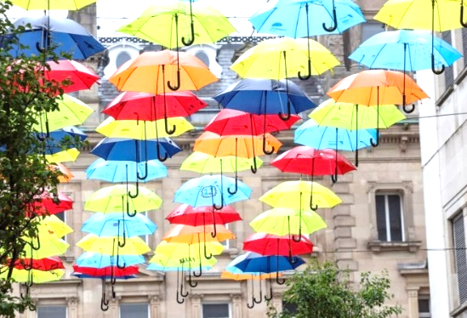
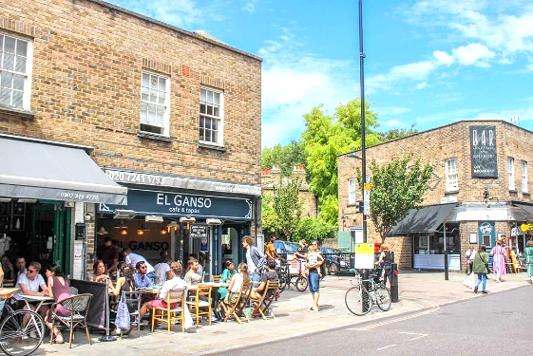
Market Drayton Town Centre - Strategy & Action Plan
9.0 Recommended Future Strategy & Action Plan
Indicative actions include (more images overleaf):
Town centre welcome signs and information boards / plans to promote all attractions, connectivity and wider reasons to use
Directional / finger signs at key interchanges
All signage and information to be of one bespoke Market Drayton style, professional design support needed, use local designers if available
Clear car park availability signage, not real time electronic, just simple clear plans
Improve the pavements, increase size where possible, conduct pram and wheelchair tests, include local mums and / or disability groups
Improve existing small squares, seating areas. Install better quality seating, bins, information, greening. Make them places people want to sit in
Include local art, school’s projects, to secure long-term, lifelong loyalty, promote authenticity, free to use leisure
Provide history tours, online accompanied guides
Create a strong, consistent Market Drayton brand
Introduce seasonal window display competitions
Create landmark arrival sculptures (Gingerbread version of Angel of the North, Wicker Man, Shirley Poppies) (see photo overleaf)
Use parked catering vehicles to improve facilities at seated spaces
9.1 How to make the town more attractive
Actions within this theme include ‘dressing’ parts of the town to detract / obscure some of the less attractive buildings (Library area). Adding more welcome and directional signs (start of Cheshire Street, car parks, pedestrian routes). It also includes more external seating to detract from vehicles as well as improved parking availability signs, traditional ‘3D’ style and themed projecting signs for buildings.
Another key area will be improved customer facilities, from toilets to pavements, shared seating areas, with more greening, possibly sponsored by major local businesses, particularly at the High Street, Queen Street and Buttermarket areas.
The town would benefit from a best kept building competition, business window display competition, incentives to maintain buildings, help with grants for historic and adjacent buildings and so on. Making Market Drayton ‘attractive’ covers all aspects of the customer experience, beyond the offer, to environment, services and facilities, promotion and memory.
Dressing for streets and hiding eyesores
Clean, positive environment in which to stay longer and socialise

Slide 64
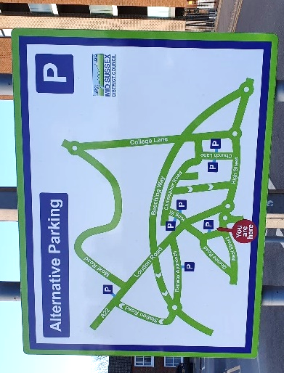
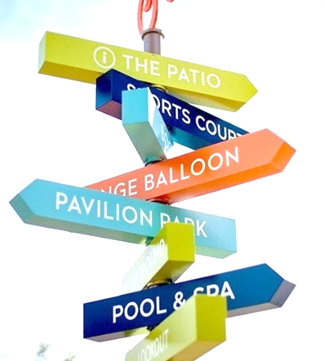
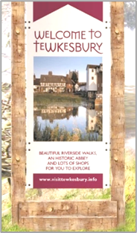
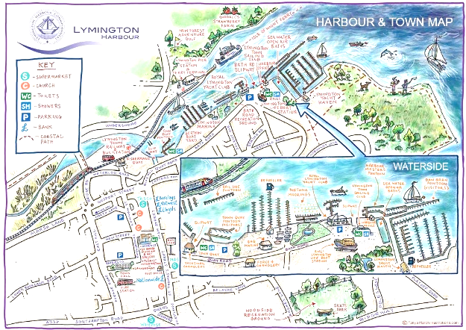
Market Drayton Town Centre - Strategy & Action Plan
9.0 Recommended Future Strategy & Action Plan
9.1 How to make the town more attractive cont’d.
Clear, helpful welcome signage and information signage
Free to use chess sets, to add to facilities
Clear links to existing and new assets
Clear place branding
Strong place branding using locally important and recognised icons
Clear and focussed plans and maps, highlighting all assets

Slide 65
Market Drayton Town Centre - Strategy & Action Plan
9.0 Recommended Future Strategy & Action Plan
Indicative actions include (more images overleaf):
With landlords' permission remove ‘closed’ signs
Use windows to promote the rest of the town, the businesses and attractions that are open
Alternatively park mobile trading vehicles in front of empty shops, services, catering, market goods
Meanwhile and temporary uses for vacant premises, include community café, repair café and facilities (bikes, garden kit, and more)
Temporary shared workspaces
Pop up shops, showrooms for local businesses, food producers, farmers, farm shops. All to test out potential for longer term businesses (note install temporary walls in larger premises)
Alternative longer term uses include
Poundland, Poundstretcher etc
Health centre (NHS plus)
Alternative health centre
Country store (TFM, regional chain)
Community Interest Company, shared workspace, meetings, café and more
Gym, Sports, Cycle
Childrens play / activity, leisure use
Small foodstore (Co-op, Tesco, JS, all not in town centre)
DIY, tools, Halfords, home and hardware
Pets Store, Garden Store
9.2 How to attract large stores to the 3 large empty retail units in the town or how they could be repurposed (B&M Store / Wilko / Argos)?
Actions within this theme include immediate use of frontages, interim meanwhile active uses and animation of spaces and full repurposing of uses with new target occupiers.
In the first instance the aim is to cover up the largescale ‘this store is closed’ message. Thereafter to encourage meanwhile activity with landlord support. With the aim of repurposing the units to meet the needs of the town, its customer groups (residents, workers and visitors). Target and fill the identified gaps in the towns offer, provide additional reasons to visit, to provide connectivity to Festival Market Drayton and to provide visible positive statement that the town is moving forward. Some of the use types identified for the three larger units will also be relevant to many of the smaller units available now and in the future in the town centre's' main streets. Create a ‘Prospectus’ to promote the town, using excellent information available. See overleaf for indicative content.
1
3
2
1 B&M, 2 Wilko, 3 Argos
Window decals, for current closures

Slide 66
Market Drayton Town Centre - Strategy & Action Plan
9.0 Recommended Future Strategy & Action Plan
9.2 How to attract large stores to the 3 large empty retail units in the town or how they could be repurposed (B&M Store/Wilko/Argos)? cont’d.
Create the Market Drayton ‘Prospectus’
The aim of the Market Drayton Prospectus is to provide potential target businesses with information that will help them to choose to open in Market Drayton.
Typically, commercial agents provide a property details pack, which contains information about the unit, size, location, rent, rates and possibly neighbours or other known ‘names’ in the town.
Whereas the Market Drayton Prospectus will provide a target business with all the information they need. Information about the resident catchment and actual catchment area, the types of customers, lifestyle information, income / spend information. Additional customer groups such as workers, visitors (both key groups for Market Drayton). It also provides more information about business trends, recent arrivals, footfall, future growth initiatives for the town, promotional and event activity. In short it provides a more rounded outline of the commercial trading opportunity. The Prospectus, can be shared with local agents and property owners to help them, it can also be sent direct to potential targets to stimulate interest.
Indicative content:
Location plan, catchment map
Customer groups information, numbers, types, access
Existing town performance, footfall, outlook
Future town initiatives
Existing mix and offer
Wider promotional and footfall drivers
Top 10 reasons to trade in Market Drayton summary
Successful example for a specific building
Example Prospectus content page

Slide 67
Market Drayton Town Centre - Strategy & Action Plan
9.0 Recommended Future Strategy & Action Plan
9.2 How to attract large stores to the 3 large empty retail units in the town or how they could be repurposed (B&M Store/Wilko/Argos)? - cont’d.
Community interest meanwhile or permanent offers
Country store for town centre location
Childrens Soft Plan, indoors, plus other leisure / café uses
Modern purpose-built town centre gym
Quality food van to cover vacant unit
Alternative and regular health centres

Slide 68
Market Drayton Town Centre - Strategy & Action Plan
9.0 Recommended Future Strategy & Action Plan
Indicative actions include (more images overleaf):
More family friendly town centre, activity, events and themed markets
More community, social, sporting events in centre
Themed activities for workers, for families, for communities, varied timings, locations
Linked promotions between venues and hospitality
A coordinated promotions group is needed
Stronger statements for existing positive assets
More external food & beverage, more shared seating, more events, demonstrations & performances
Make it easy for visitors to become customers, cross promotion of assets and activity
Target gaps in the offer and opportunities to extend appeal … specialist comparison goods, local makers and artisans, independents, artisans and local producers, service and repair, day spa, health, beauty, alterations, up-cycle, re-cycle, active, passive and social leisure e.g. climbing, indoor golf, darts, cricket, football (table and mini), ping pong, martial arts, arts, drama, reading, book clubs, kids play, toddler play and more
Increased promotional activity, targeting the 107,000 resident, linked regional visitor promotion, targeting the workers.
Develop a promotional plan
9.3 How to encourage shoppers / visitors / tourists to the town?
Actions within this theme include enabling existing visitors to use more of the town, attracting more visitors to the town, encouraging more local workers into the town. A key area will be more cross promotion of the town and its attractions, by the attractions and elements of the town offer. Promote the town as a multi purpose location, working with partners. Encourage businesses to collaborate with each other and deliver collective initiatives.
It also includes expanding and improving the offer of the town, adding more reasons to visit, more often. Targeting missing or underserved categories. Fill gaps in the towns offer, aligning the offer and experience with current trends and best practice.
This theme also includes improving the quality and quantity of promotional activity for the town centre and the businesses within it. It includes more collective promotion and helping businesses with their own promotional activity. A collective approach will require a ‘team’ to plan and deliver a layer of promotional activity.
1
3
Additional small scale leisure
Multi-purpose location, many reasons to visit

Slide 69
Market Drayton Town Centre - Strategy & Action Plan
9.0 Recommended Future Strategy & Action Plan
9.3 How to encourage shoppers / visitors / tourists to the town? - cont’d.
Stronger external impact for businesses
Themed guides and promotion
Directional signage, within town, linking assets
Effective online promotion and information, promoting whole town and surroundings
Focus on strengths
Events can be small scale and local

Slide 70
Market Drayton Town Centre - Strategy & Action Plan
9.0 Recommended Future Strategy & Action Plan
Indicative actions include (more images overleaf):
Stronger ‘Market Trading Today’ signage around the town and at arrival points
Clear listings of who / what stalls are available today
Branding for any themed areas of the market
Improved display standards and trading facilities throughout the market
Stronger Market Drayton Markets branding on all stall canopies
Connecting / directional signage between market components
More grab and go food items, with additional promotion to local workers, locate stalls where it will be easy for workers to access
Additional themed markets, on existing trading day and other days
More local producers to have stalls on market, and in Market Hall
Consider relocating market hall to larger unit, swap with Town Council building, to facilitate larger market, with an event space
Pro-active recruitment of market traders, use mini version of Prospectus
Improve layout, to make more use of space outside of Library and behind Buttermarket onto High Street
More social media activity and linked promotions with town centre and local events
9.4 How to improve the market offer?
The markets offer, including the street market, the Market Hall and the artisan market, is an important part of the town centre offer. Whilst the core street market is now back under the control of Shropshire Council, there are several actions needed to improve the offer. These range from improving the delivery and presentation of the street market, adding more categories, more stalls, more choice, introducing additional themed markets, as periodic or visiting on a regular basis. All with a stronger emphasis for more local producers.
The Market Hall would benefit from more visibility, signage, impact, additional external trading, possibly enlarging / relocating (the Town Council Building may provide an alternative home, with the Town Council team relocating).
The artisan market needs to offer a better experience and make better use of the Buttermarket as a base to expand from.
Additional street food, worker focus
Younger traders, specialist categories

Slide 71
Market Drayton Town Centre - Strategy & Action Plan
9.0 Recommended Future Strategy & Action Plan
9.4 How to improve the market offer? - cont’d.
More local services for the community
Themed additional markets
Council and national activities on the market
Themed signage, and connecting signage
More food choices on market
Themed stalls for artisan market

Slide 72
Market Drayton Town Centre - Strategy & Action Plan
10.0 In Summary
10.1 Outlook and Next Steps
Market Drayton has much to be positive about, and despite the study identifying many opportunities to improve its future performance, it is also evident that there are many strengths and positive attributes in place.
The key is to start with completing actions that will make better use of the existing strengths, assets and attributes. In common with many towns and places, the existing assets are being taken for granted, or even neglected. Simply improving the promotion of, connectivity to and awareness of the many different assets will lead to improved footfall, customer visits and town performance. Businesses working collectively will also provide a strong boost.
The assets include physical, canal, buildings, church, streets, events, leisure , arts and culture, as well as the variety of specialists and service providers. They also include the larger than expected customer base, the significant local workforce and the regional visitors.
There are also some aspects of the existing Market Drayton experience that need improvement, and are lagging those at other regional centres, Shrewsbury and Whitchurch. The built environment and public realm in places is below the standards set by some of the better-quality assets, and this reduces the overall appeal. Pavements are narrow, poorly maintained and difficult in places. Many buildings need improvement, maintenance and occasionally obscuring.
The general level of vacancies across the town centre is positive, and indeed are likely to be replaced with new businesses or repurposed to residential in some places, the town centre already has a strong residential component. The pressing issue are the three larger and high-profile units around Frogmore Road Car Park. These are all vacant due to national pressures, not local issues, indeed B&M have moved to larger local premises. The study has identified plenty of new potential uses, some are retail, others are not. All will provide additional reasons to choose to use Market Drayton. It will need a proactive approach to fill these units, simply waiting and hoping won’t work. Proactive and positive action is needed..
The market has plenty of potential for improvement and growth, there are opportunities to improve the existing market offer, add more themes and categories and make more use of local producers and specialists.
The town has several established events, there is a clear need to expand on these in terms of more events, large and small, more integration to existing assets and their events, and more opportunities to develop more bespoke local community events.
The Town Council will need to work with and collaborate with a variety of partners to deliver and implement all the growth actions, the partners will all benefit from implementing the identified actions. A workshop to share the findings, agree, schedule and allocate actions is the next immediate step to achieving an improved town offer. To be clear, the outlook for Market Drayton Town Centre is positive!

Slide 73
The Retail Group
Informed Solutions
Web. www.theretailgroup.co.uk
Email. info@theretailgroup.co.uk
Dunnings Oak Offices
Dunnings Road
East Grinstead
West Sussex, RH19 4AT

